Slide 1
Test4Time
Sprint 1
David Fletcher, Alan Bunch, Halston Raddatz, Trevor Chappell

Slide 2
Short background of project
Creating an application that allows users to restrict access to applications until activity goals are met.

Slide 3
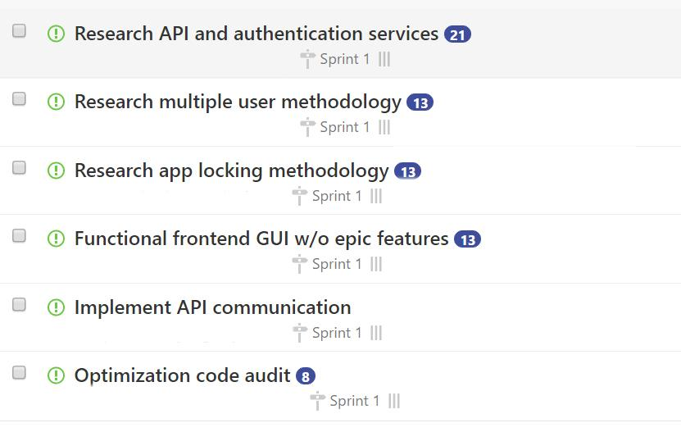
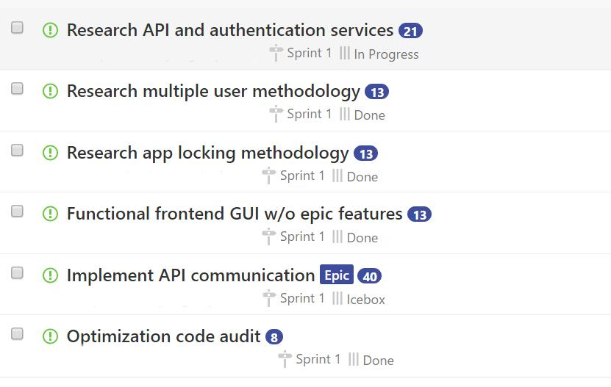
Intended progress vs actual progress

Slide 4
Locker
Progress:
Functional locker that launches our app when another app is on the front of the screen.
Compatible with android versions 5.1 and newer.
Next Steps:
Make a whitelist/blacklist activity to choose blocked apps.
Disable the locker for admin users.
Permit apps when exercise goals are met.
Launch app on device startup.

Slide 5
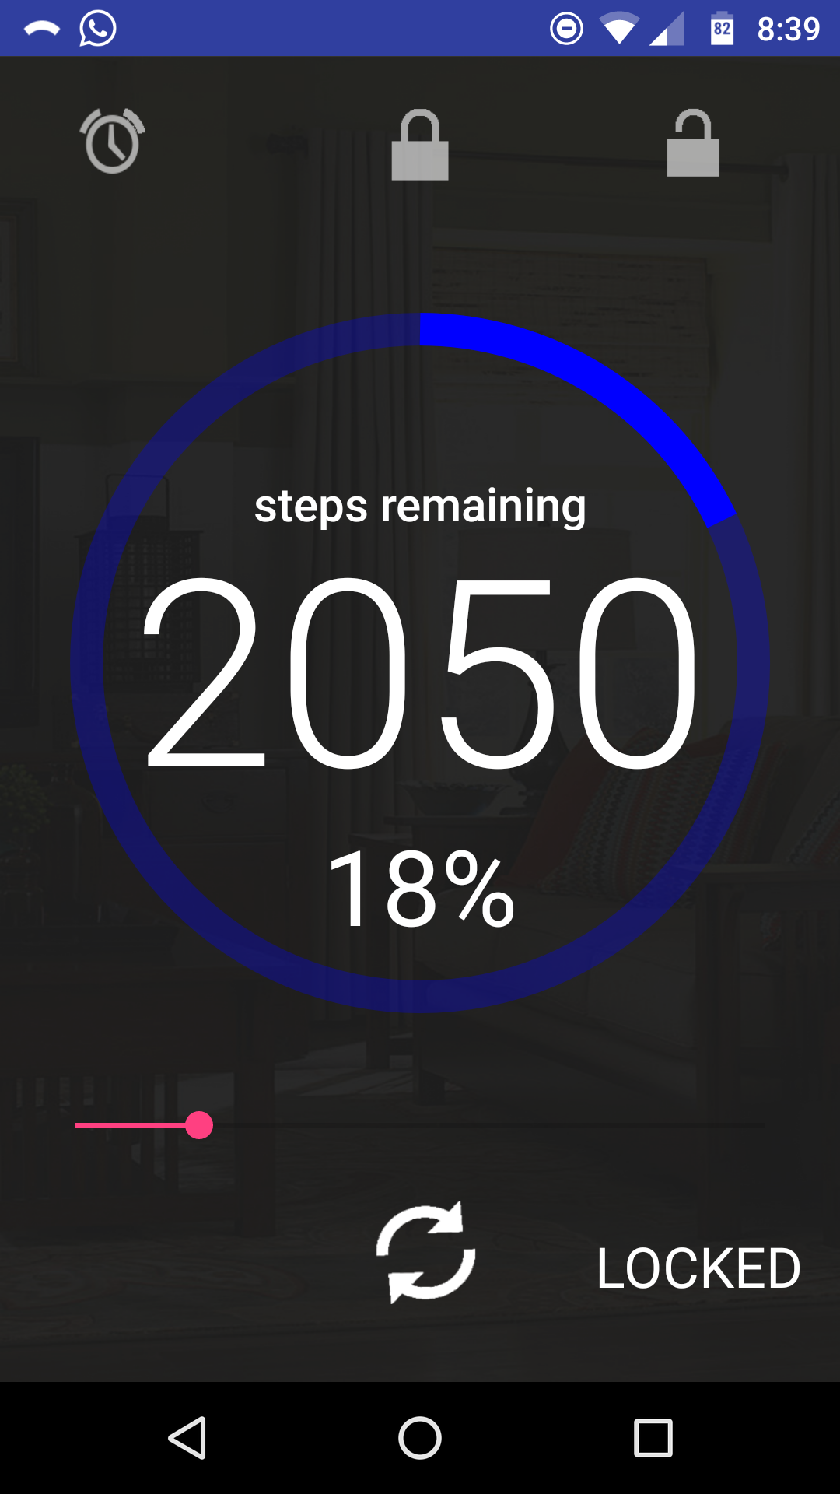
Functional GUI w/o epic features
Progress
Done
Setbacks:
Lack of android studio knowledge (gradle is a pain)
Future: Implementing epic features and beautifying

Slide 6
API/auth
Progress:
Application setup through Fitbit
OAuth2 Authorization
HTTP Requests (Apache)
Setbacks:
Incorrect Evaluations of Time Estimates
Issues could have broken down more

Slide 7
User accounts
Progress:
Built in functions for user accounts
Writes and reads from a plain text file
Easy to implement, no encryption needed
Next steps:
Locking accounts with password or pin
Setting up admin account

Slide 8
Goal for sprint 2:
User and admin accounts implemented
API implemented & syncing with app
Locker implemented

